Slide 1


T1A3 Terminal Application
Philip Mills

Slide 2
Amoria text-based dungeon adventure

Slide 3
Main Features
CLASS SELECTION
- User Input
- Output relevant to class used during COMBAT
DUNGEON GAMEPLAY
- User Input to:
- Move rooms Relevant output for next room description
- Access inventory Relevant output to display inventory
- Explore room Relevant output for additional descriptions
COMBAT
- User Input for action and skill usage
- Output displays damage dealt, along with damage taken
INVENTORY MANAGEMENT
- User Input – equipping/unequipping items, use items
- Output displays updated inventory or item use fail or success

Slide 4
Code overview
Split into 4 separate files
Character.py
Enemies.py
Inventory_items.py
Main.py
Python Packages
Random
Prettytable
Colorama
Textwrap
Function dependant

Slide 5
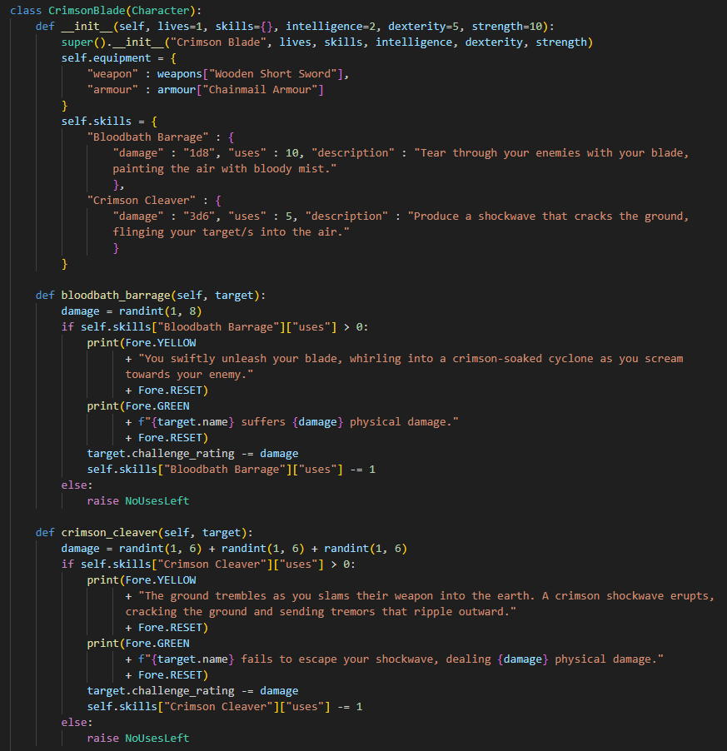
Character.py
Parent class: Character
Includes functions for returning and calculating gear scores, along with a normal attack function
Child Classes: NightWhisperer, CrimsonBlade, SunsHunter
Starting equipment
Skills
Skill functions

Slide 6
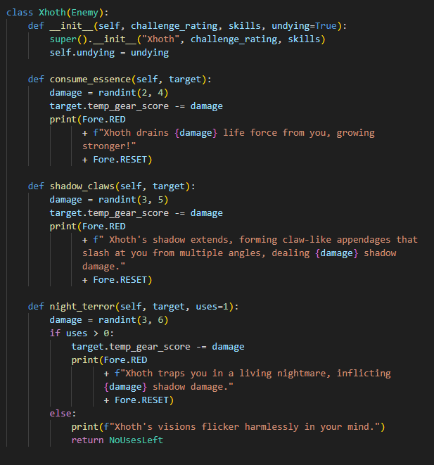
Enemies.py
Parent Class: Enemy
Child Classes: MossHaggardens, BoneGnashers, Whisperers, Gloomweavers, Xhoth(BOSS)
Challenge Rating
Skill functions

Slide 7
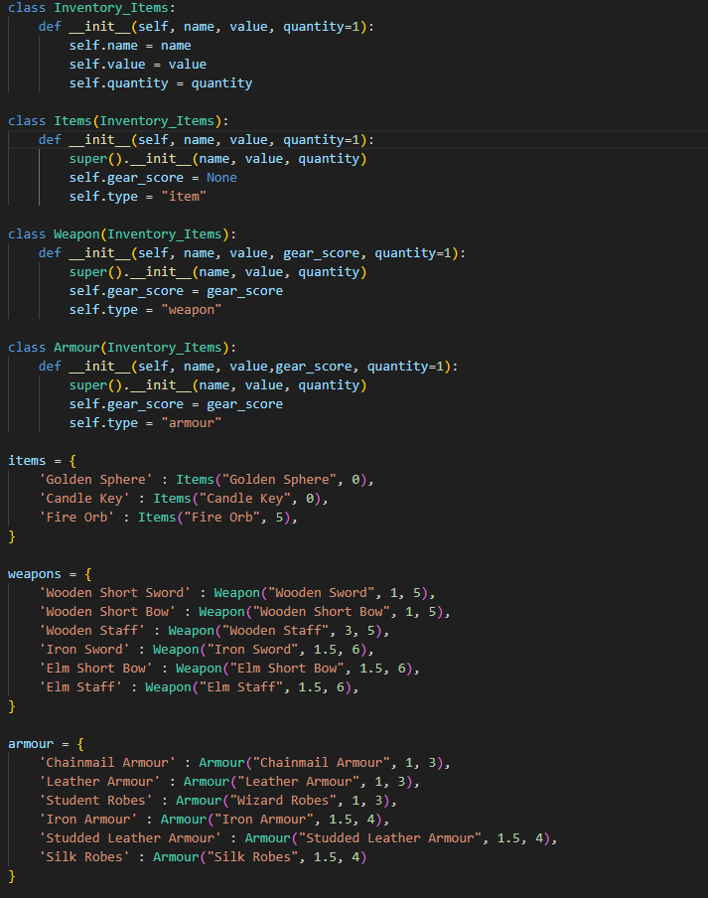
Inventory_items.py
Parent Class: Inventory_Items
Child Classes: Items, Weapon, Armour
Objects: items, weapons, armour
Dictionary used to initialise all available items

Slide 8

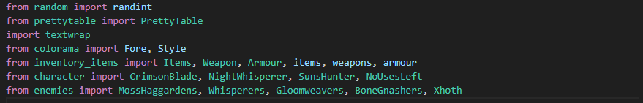
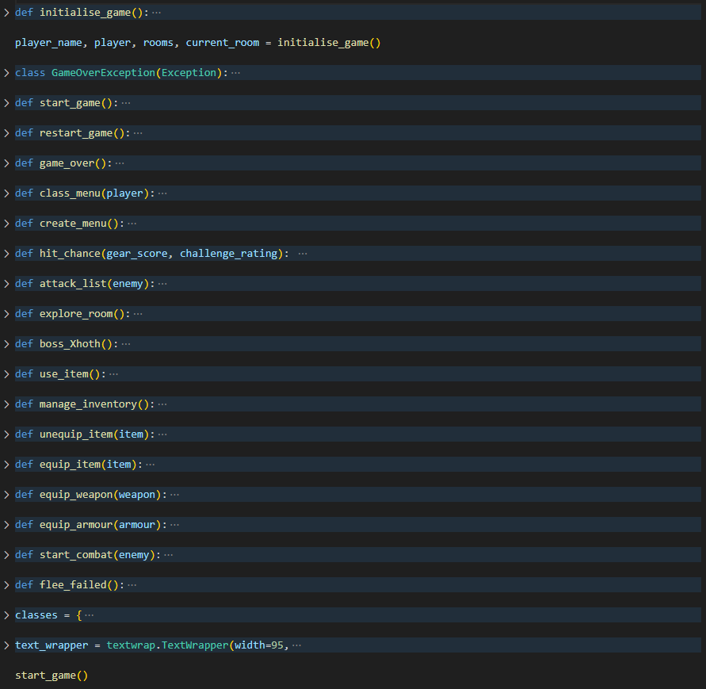

Main.py
All loops within relevant functions
Start_game() holds the main gameplay loop and sets player class. The loop itself uses: class_menu(), boss_Xhoth(), create_menu(), explore_room(), manage_inventory(), game_over() and restart_game()
Initialise_game() resets game variables
Game_over() – option to quit or restart
Restart_game() – restarts game and resets variables using initialise_game()
Manage_inventory() uses all other functions to manage the players inventory – unequip_item(), equip_item(), equip_weapon(), equip_armour()
Start_combat() holds the main combat loop, uses attack_list() function to call upon class functions of the player, and manages enemy combat as well
Classes defined within a dictionary to be able to print table
Text_wrapper variable used to constantly call on textwrapper used for creation

Slide 9

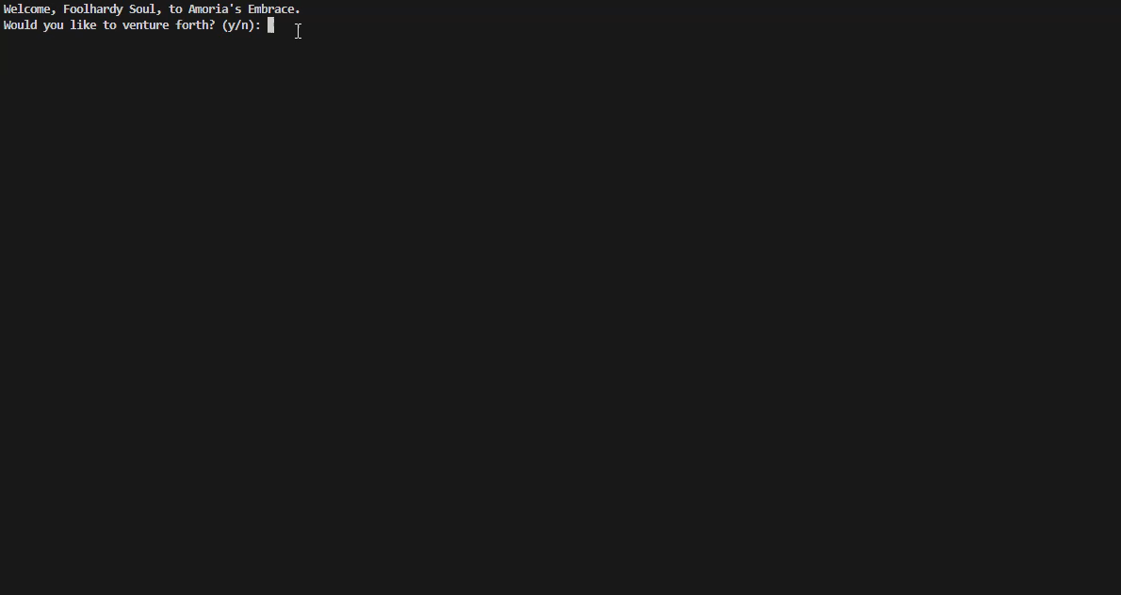
Ending Discussion
- Code Creating
- Planning & Timing
- Overall Experience

